Slide 1
This Keyword
By : Neha P. Rajas
Asst. Prof. VIT

Slide 2
If there is ambiguity between the instance variable and parameter, this keyword resolves the problem of ambiguity
The this keyword can be used to refer current class instance variable.

Slide 3
public class ThisDemo
{
int id;
String name;
}
ThisDemo(int id, String name)
{
id = id; //compiler error
name = name; //compiler error
}
void display()
{
System.out.println(id+" "+name);
}
Resolve the problem
public class ThisDemo
{
int id;
String name;
}
ThisDemo(int id, String name)
{
this.id = id;
this.name = name;
}
void display()
{
System.out.println(id+" "+name);
}

Slide 4
public static void main(String args[])
{
ThisDemo s1 = new ThisDemo(111,"Karan");
ThisDemo s2 = new ThisDemo(321,"Aryan");
s1.display();
s2.display();
}
}

Slide 5
The this keyword can be used to invoke current class method (implicitly).
You may invoke the method of the current class by using the this keyword. If you don't use the this keyword, compiler automatically adds this keyword while invoking the method. Let's see the example

Slide 6
public class ThisDemo3
{
void m()
{
System.out.println("method is invoked");
}
void n()
{
m();//no need because compiler does it for you.
}

Slide 7
void p()
{
n();//complier will add this to invoke n() method as this.n()
}
public static void main(String args[])
{
ThisDemo3 s1 = new ThisDemo3();
s1.p();
}
}

Slide 8
this keyword can be passed as an argument in the method
The this keyword can also be passed as an argument in the method. It is mainly used in the event handling. Let's see the example

Slide 9
class S2{
void m(S2 obj)
{
System.out.println("method is invoked");
}
void p()
{
m(this);
}
public static void main(String args[])
{
S2 s1 = new S2();
s1.p();
}
}

Slide 10
Type Typical Bit Width
char 1byte
unsigned char 1byte
signed char 1byte
int 4bytes
unsigned int 4bytes
signed int 4bytes
short int 2bytes
long int 4bytes

Slide 11
this keyword in Java

Slide 12
this pointer in C++
this pointer is used to represent the address of an object inside a member function.
For example, consider an object obj calling one of its member function say method() as obj.method().
Then, this pointerwill hold the address of object obj inside the member function method().

Slide 13
class student
{
int dataMember;
method(int a)
{
this->dataMember = a;
//this pointer stores the address of object obj and access dataMember
}
}
public static void main()
{
student obj;
obj.method(5);
}

Slide 14
‘this’ pointer
The ‘this’ pointer is passed as a hidden argument to all nonstatic member function calls.
‘this’ pointer is a constant pointer that holds the memory address of the current object.
‘this’ pointer is not available in static member functions as static member functions can be called without any object (with class name).

Slide 15
Following are the situations where ‘this’ pointer is used:
1) When local variable’s name is same as data members of class.
2) To return reference to the calling object

Slide 16
class Test{
int x;
Test(int a)
{ x = a; //x=20
}
void print()
{ System.out.println("x= "+x);
}
}
public class Main{
public static void main(String[] args) {
Test ob=new Test(20);
ob.print();
}
}

Slide 17
class Test{
int x;
Test(int x)
{ x = x; //garbage value
}
void print()
{ System.out.println("x= "+x);
}
}
public class Main{
public static void main(String[] args) {
Test ob=new Test(20);
ob.print();
}
}

Slide 18
class Test{
int x;
Test(int x)
{ this.x = x; //x=20
}
void print()
{ System.out.println("x= "+x);
}
}
public class Main{
public static void main(String[] args) {
Test ob=new Test(20);
ob.print();
}
}

Slide 19
Following are the situations where ‘this’ pointer is used:
2) To return reference to the calling object

Slide 20
class test
{ int x;
public:
test max(test &ob2){
if(ob2.x>x)
return ob2; // argument object
else
//return ob1; //error
return this; //calling object
}
};
void main()
{ test ob1(10),ob2(20),ob3;
ob3=ob1.max(ob2);
ob3.display();
}

Slide 21
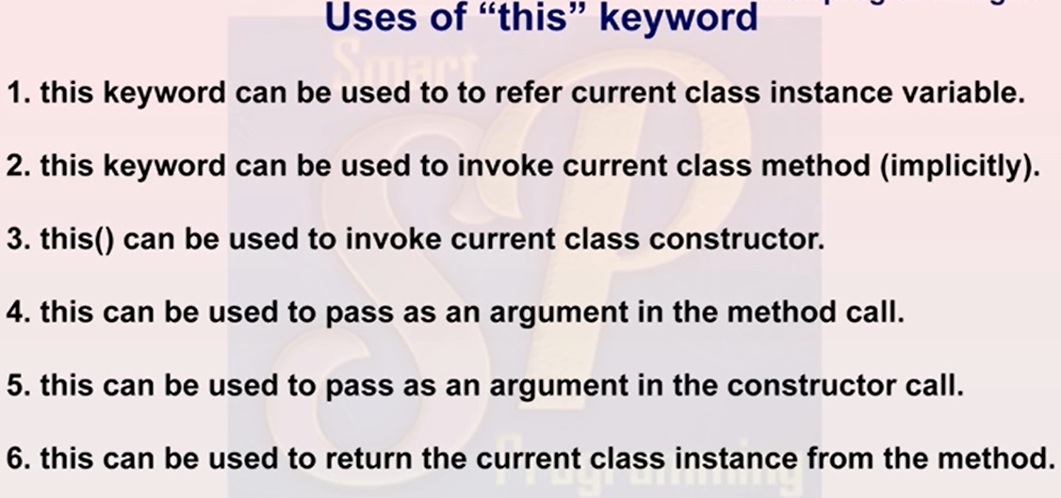

Slide 22
class Test{
int x;
Test(int x)
{ this.x = x; //x=20
}
void print()
{ System.out.println("x= "+x);
}
}
public class Main{
public static void main(String[] args) {
Test ob=new Test(20);
ob.print();
}
}

Slide 23
class Test
{ int x;
Test(int x)
{
this.x = x; //x=20
}
void print() { cout << x }
};
int main()
{
Test obj=new Test(20);
obj.print();
}

Slide 25
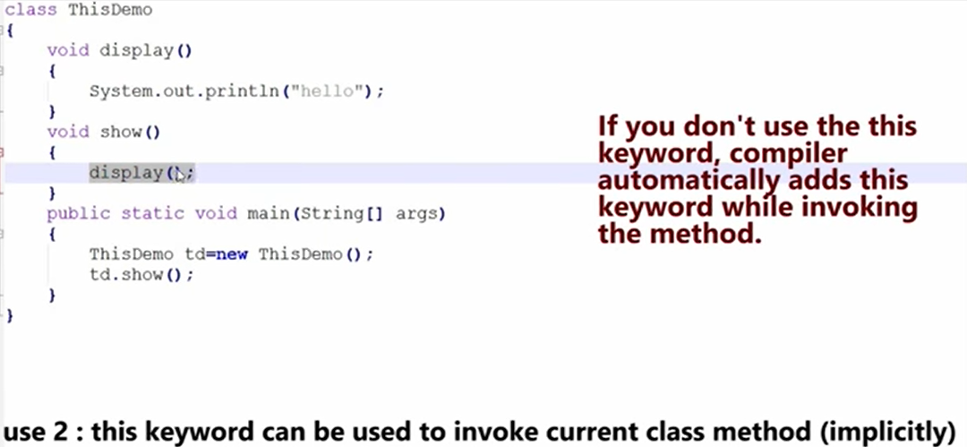

Slide 26
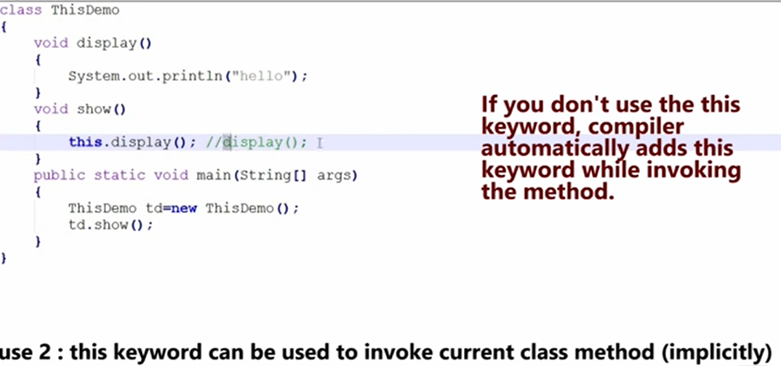

Slide 28
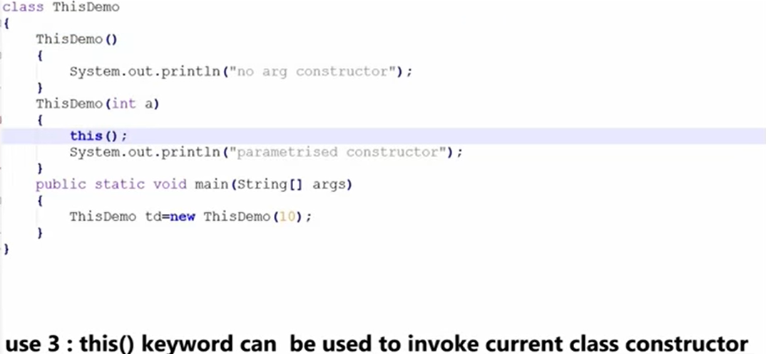

Slide 29
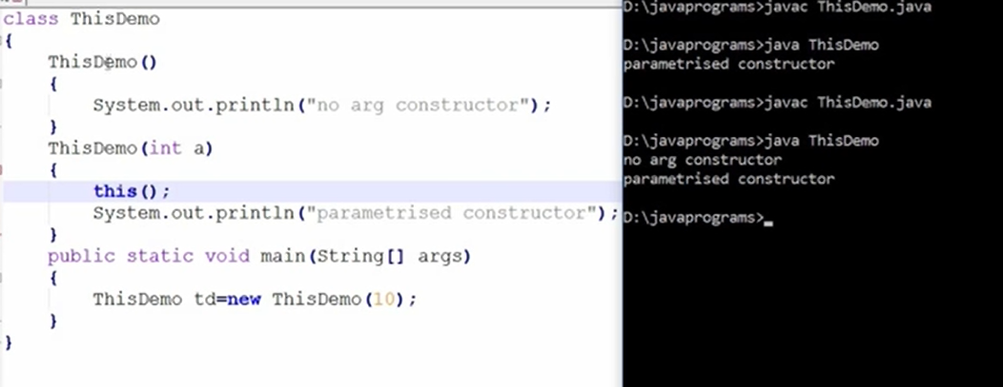

Slide 30
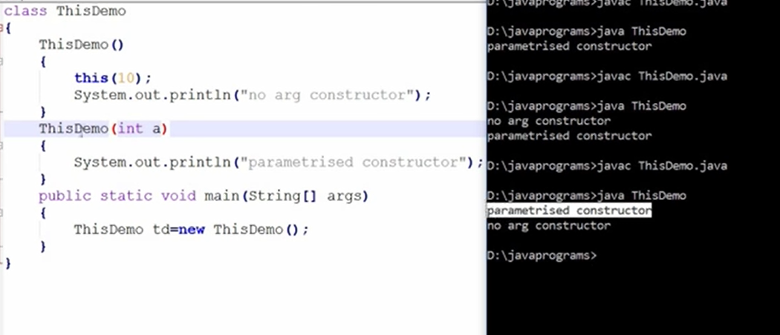

Slide 32
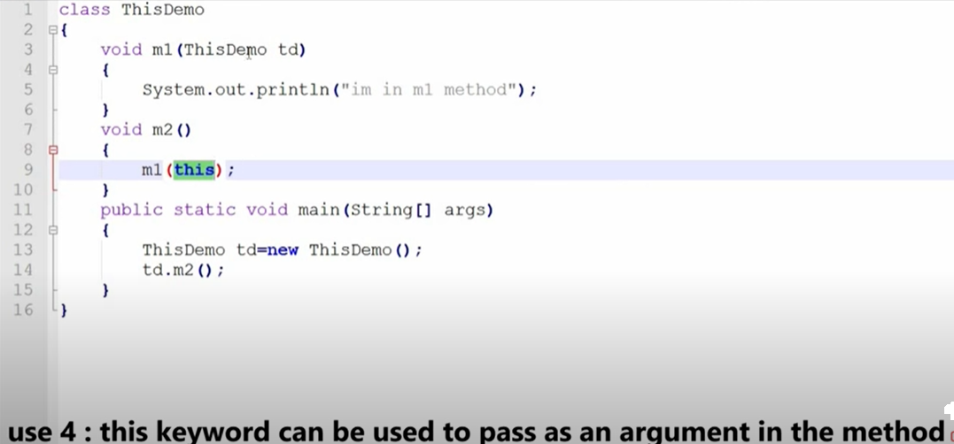

Slide 33
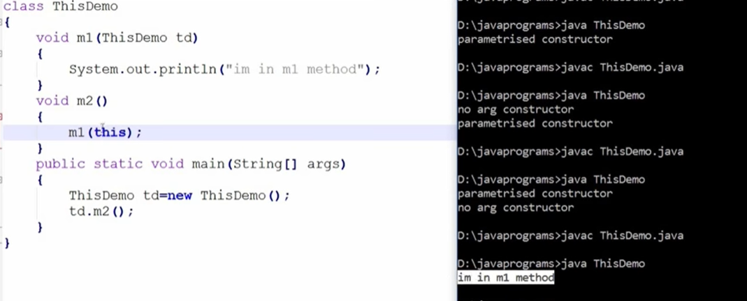

Slide 35
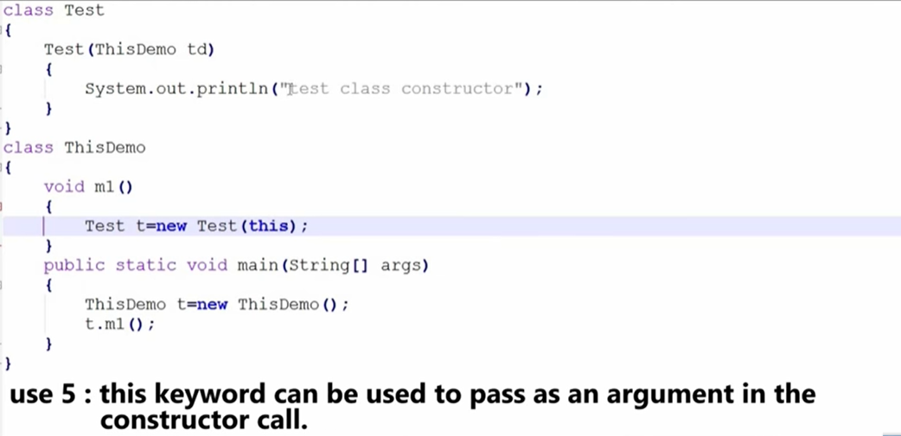

Slide 37
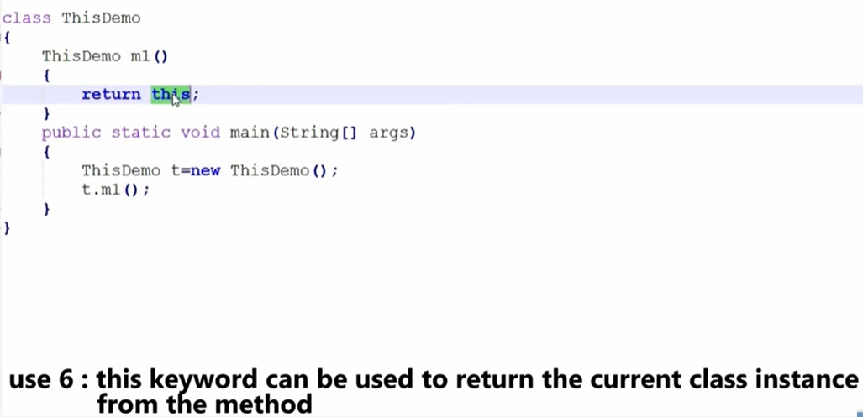

Slide 38
Dynamic memory allocation
Compile time:
Memory is allocated depending upon type & size of data.
Run time:
new & delete operators
Malloc (), calloc(), realloc() //allocation C
Free() //deallocation

Slide 39
new operator
pointer_variable= new data_type
int *i = new int;
float *j = new float;
char *j = new char;
int *i = new int[5]; allocates memory for an array of 5 integers
float *i = new float[5]; allocates memory for an array of 5 floats

Slide 40
delete operator
Deallocate memory
delete pointer_variable;
delete i;
delete []a;

